Slide 1
Approaches to AI (revision)
Acting humanly: The Turing Test approach
Shows intelligent behavior of machine/system/program i.e. they must have the ability to achieve human-level performance in all cognitive tasks, sufficient to fool an interrogator.
natural language processing
knowledge representation
automated reasoning
machine learning
Thinking humanly: The cognitive modeling approach
If we are going to say that a given program thinks like a human, we must have some way of determining how humans think. We need to get inside the actual workings of human minds.
Introspection
psychological experiments.

Slide 2
Thinking rationally: The laws of thought approach
Aristotle was one of the first to attempt to codify "right thinking“. Syllogisms: For example: "Socrates is a man; all men are mortal; therefore Socrates is mortal.“
These laws of thought were supposed to govern the operation of the mind, and initiated the field of logic.
Acting rationally: The rational agent approach
Acting rationally means acting so as to achieve one's goals, given one's beliefs. The study of AI as rational agent design therefore has two advantages.
It is more general than the "laws of thought" approach, because correct inference is only a useful mechanism for achieving rationality, and not a necessary one.
It is more amenable to scientific development than approaches based on human behavior or human thought, because the standard of rationality is clearly defined and completely general.

Slide 3
THE FOUNDATIONS OF ARTIFICIAL INTELLIGENCE
AI is a young field, it has inherited many ideas, viewpoints, and techniques from other disciplines.
From over 2000 years of tradition in philosophy, theories of reasoning and learning have emerged, along with the viewpoint that the mind is constituted by the operation of a physical system.
From over 400 years of mathematics, we have formal theories of logic, probability, decision making, and computation.
From psychology, we have the tools with which to investigate the human mind, and a scientific language within which to express the resulting theories.
From linguistics, we have theories of the structure and meaning of language.
Finally, from computer science, we have the tools with which to make AI a reality.

Slide 4
Philosophy (428 B.C. - present)
Plato, a philosopher, writes range across politics, mathematics, physics, astronomy, and several other branches of philosophy.
Plato, his teacher Socrates and his student Aristotle describe the working of the mind.
Socrates was asking for an algorithm to distinguish piety from non-piety.
Aristotle went on to try to formulate more precisely the laws governing the rational part of the mind. He developed an informal system of syllogisms for proper reasoning, which in principle allowed one to mechanically generate conclusions, given initial premises.
Aristotle did not believe all parts of the mind were governed by logical processes; he also had a notion of intuitive reason.

Slide 5
Consider, mind as a physical system.
Rene Descartes (1596-1650) made clear distinction between mind and matter (body) and was also supporter of dualism.
Dualism
Mind is a nonphysical and therefore non-spatial substance. Mind has consciousness and self-awareness while brain is physical. Hence, he was the first to formulate the mind–body problem in the form in which it exists today.
Materialism (Wilhelm Leibniz (1646-1716))
Alternative to dualism
Holds that all the world (including the brain and mind) operate according to physical law.
Build a mechanical device intended to carry out mental operations.
Unfortunately, his formulation of logic was so weak that his mechanical concept generator could not produce interesting results.

Slide 6
Establish the source of knowledge.
Empiricist Movement:
David Hume's (1711-1776) -principle of induction- repeated associations between their elements.
Bertrand Russell (1872-1970)- logical positivism- all knowledge can be characterized by logical theories connected, ultimately, to observation sentences that correspond to sensory inputs
Rudolf Carnap and Carl Hempel- confirmation theory – to understand how knowledge can be acquired from experience.
Connection between knowledge and action

Slide 7
Mathematics
Three main areas:
Computation
David Hilbert (1862-1943)- if there is an algorithm for deciding the truth of any logical proposition involving the natural numbers (decision problem).
Kurt Godel (1906-1978) showed that there exists an effective procedure to prove any true statement in the first-order logic.
Incompleteness theorem- there are true statements that are undecidable i.e their truth cannot be established by any algorithm.
Turing machine (Turing, 1936) is capable of computing any computable function.
Turing also showed that there were some functions that no Turing machine can compute. For example, no machine can tell in general whether a given program will return an answer on a given input, or run forever.

Slide 8
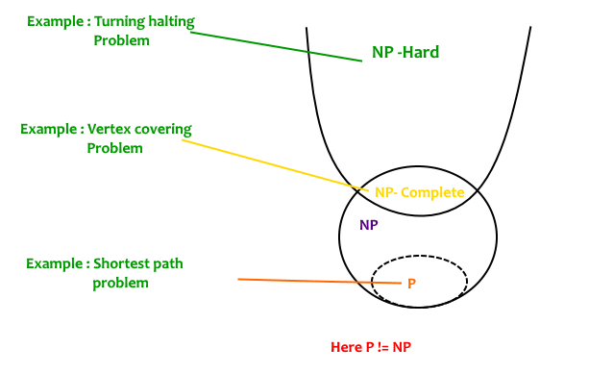
Intractability- A class of problems is called intractable if the time required to solve instances of the class grows at least exponentially with the size of the instances.
Reduction- A reduction is a general transformation from one class of problems to another, such that solutions to the first class can be found by reducing them to problems of the second class and solving the latter problems.
NP-complete- If a problem is NP and all other NP problems are polynomial-time reducible to it, the problem is NP-complete.

Slide 9
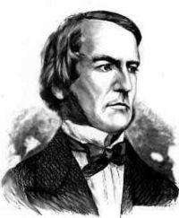
2. Logic
George Boole (1815-1864) introduced his formal language for making logical inference in 1847.
Drawback- Boole's approach was incomplete, but good enough that others filled in the gaps.
Gottlob Frege (1848-1925) produced a first-order logic that is used today as the most basic knowledge representation system.
Alfred Tarski (1902-1983) introduced a theory of reference that shows how to relate the objects in a logic to objects in the real world.
George Boole

Slide 10
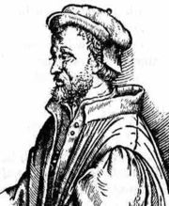
3. Probability
Gerolamo Cardano (1501-1576) first framed the idea of probability, describing it in terms of the possible outcomes of gambling events.
James Bernoulli (1654-1705) also framed an alternative view of probability, as a subjective "degree of belief“.
Thomas Bayes (1702-1761) proposed a rule (Bayes' rule based on conditional probability) for updating subjective probabilities.
Decision theory (John Von Neumann and Oskar Morgenstern (1944)) – combines probability theory with utility theory (maximization of utility) to distinguish good actions from bad ones.
Cardano

Slide 11
Psychology (1879-present)
How do humans think and act?
The study of human reasoning and acting.
Provides reasoning models for AI.
Strengthen the ideas
humans and other animals can be considered as information processing machines
Based on cognitive science - computer models can be used to understand the psychology of memory, language and thinking.

Slide 12
Computer Engineering (1940-present)
How to build an efficient computer?
Provides the artifact that makes AI application possible.
The power of computer makes computation of large and difficult problems more easily.
Plankalkul, the first high-level programming language
Konrad Zuse (1941)- invented first operational programmable computer Z-3.
Mark I, II, and III computers were developed at Harvard

Slide 13
ENIAC was developed at the University of Pennsylvania (first general-purpose, electronic, digital computer)
IBM 701 (1952) - the first computer to yield a profit for its manufacturer. IBM went on to become one of the world's largest corporations, and sales of computers have grown to $150 billion/year.
Each generation of computer hardware has brought an increase in speed and capacity, and a decrease in price.
Calculating devices - abacus is roughly 7000 years old.
Blaise Pascal (mid-17th century) built a mechanical adding and subtracting machine called the Pascaline.
Leibniz (1694) built a mechanical device that multiplied by doing repeated addition.

Slide 14
Linguistics 1957-present
Language is ambiguous and leaves much unsaid.
This means that understanding language requires an understanding of the subject matter and context, not just an understanding of the structure of sentences.
In early 1960’s knowledge representation (the study of how to put knowledge into a form that a computer can reason with) was tied to language .
Computational linguistics or natural language processing fields concentrate on the problem of language use.

Slide 15
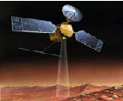
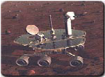
AI Applications
Autonomous Planning & Scheduling:
Autonomous rovers.

Slide 16
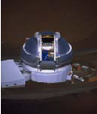
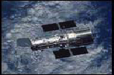
AI Applications
Autonomous Planning & Scheduling:
Telescope scheduling

Slide 17



AI Applications
Autonomous Planning & Scheduling:
Analysis of data:

Slide 18
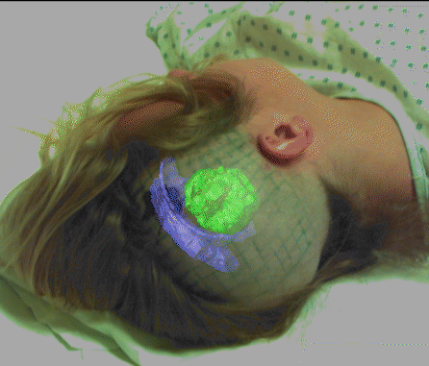

AI Applications
Medicine:
Image guided surgery

Slide 19

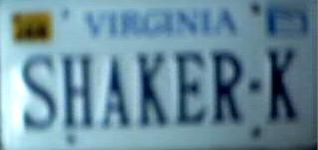


AI Applications
Medicine:
Image analysis and enhancement

Slide 20

AI Applications
Transportation:
Autonomous vehicle control:

Slide 21

AI Applications
Transportation:
Pedestrian detection:

Slide 22
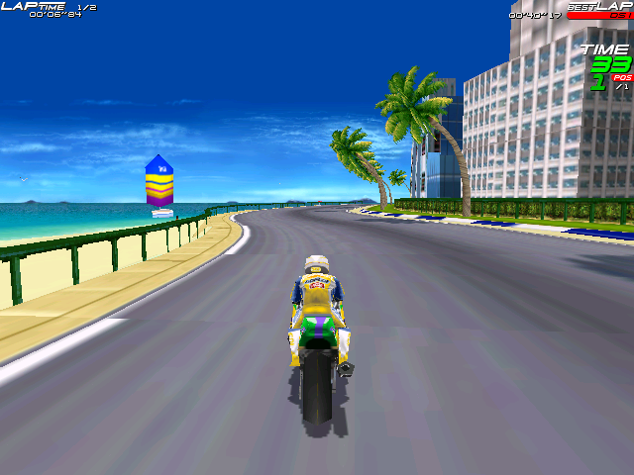
AI Applications
Games:

Slide 23
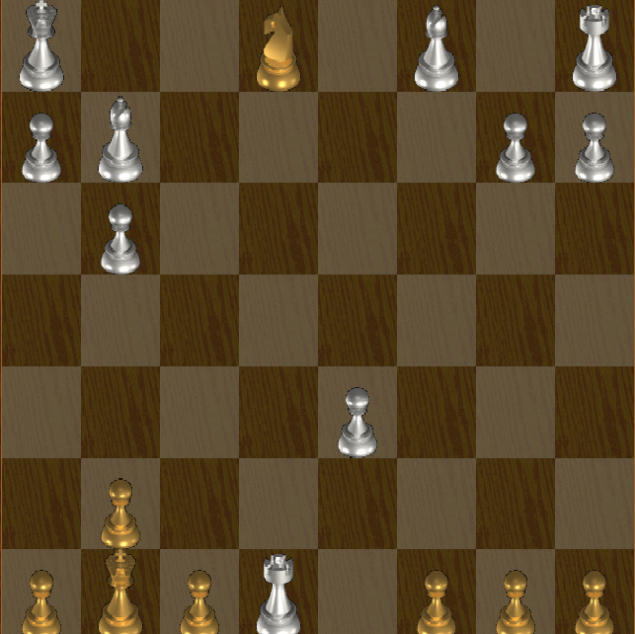
AI Applications
Games:

Slide 24
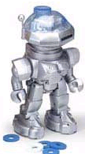

AI Applications
Robotic toys:

Slide 25
AI Applications
Other application areas:
Bioinformatics:
Gene expression data analysis
Prediction of protein structure
Text classification, document sorting:
Web pages, e-mails
Articles in the news
Video, image classification
Music composition, picture drawing
Natural Language Processing .
Perception.

Slide 26
Some Advantages of Artificial Intelligence
More powerful and more useful systems
New and improved interfaces
Solving new problems
Better handling of information.
Relieves information overload.
Conversion of information into knowledge.

Slide 27
Disadvantages
Increased costs
Difficulty with software development - slow and expensive
Very few experienced programmers.
Few practical products have reached the market as yet.

Slide 28
THE HISTORY OF ARTIFICIAL INTELLIGENCE

